Slide 1
Web Survey System
Drop Table team;

Slide 2
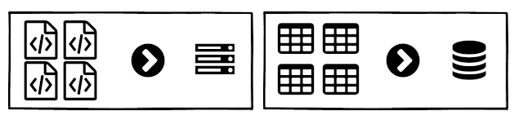
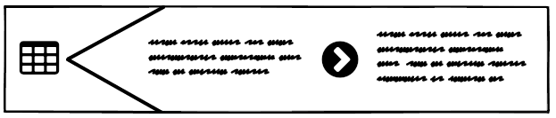
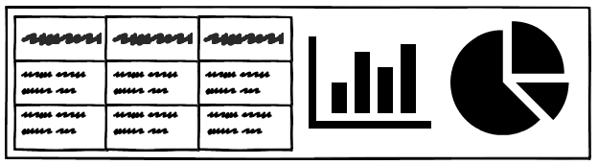
Project Definition
Web-based survey system
Can be implemented on any website
Customizable questions and email script
Generates insightful reports from responses

Slide 3
What makes it unique?
Semantic Differential Questions (w/ Likert Scale)
Survey Structure Targets Companies of Any Size
Left Statement (Positive) |  |  |  | Right Statement (Negative)
 | Strongly Agree | Mostly Agree | Partly Agree | Partly Agree | Mostly Agree | Strongly Agree
CSC 490 is great! | • | ◦ | ◦ | ◦ | ◦ | ◦ | CSC 490 is awful!
 | 1 ➡ ∞ |  | 1 ➡ ∞ |  | 1 ➡ ∞
Company |  | Survey |  | Department |  | Participant

Slide 4
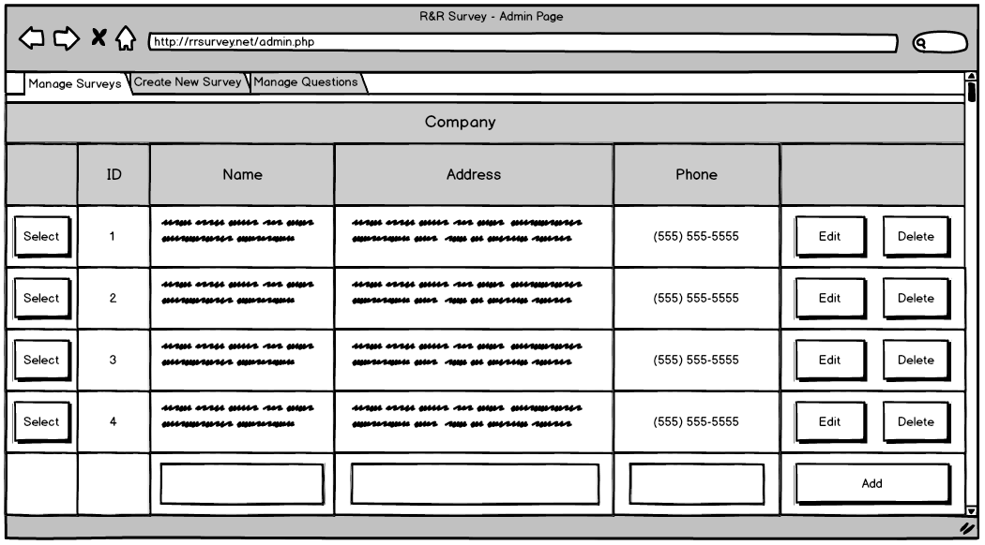
Mockup Walkthrough

Slide 5
Requirement Specification
Administrative Page
Requires login to access
Used to generate surveys
Create a record for a company (or select existing)
Create records for each department involved in survey
Generate participant records from email list
Automatic emails are sent out with link to survey

Slide 6
Requirement Specification
Administrative Page
Features for managing ongoing surveys
Send email to participant who has lost the survey link
Send reminder emails to participants that have not completed the survey
Add, remove, and move participants between departments
Features for generating reports
Reports should be in Excel
Reports should include charts and graphs

Slide 7
Requirement Specification
Survey Page
Requires a unique ID in the hyperlink to access
Corresponds with ID generated for participant
Included as part of automatic email
Survey must be completed before it can be submitted
Should point user to any missed questions
Survey can only be submitted once
User should be notified prior to submitting
Notification should be displayed on re-opening page
Responses should be anonymous

Slide 8
Requirement Specification
Database
The database will be implemented using MySQL
Relational database
Free and open-source
The schema should be efficiently designed
Relationships used to eliminate redundant data

Slide 9
Subsystems
Admin Page
Manage Survey Tab
Create New Survey Tab
Manage Questions Tab
Email System
Survey Page
Database

Slide 10
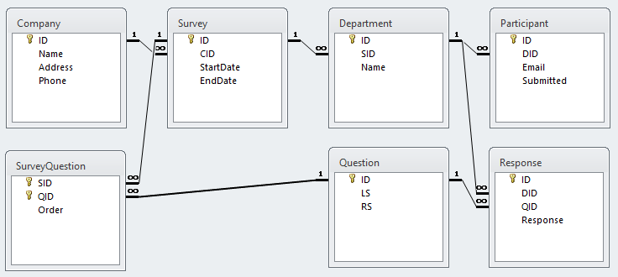
ER Diagram

Slide 11
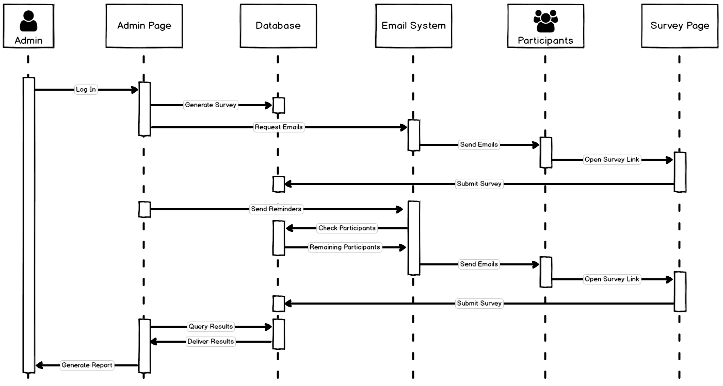
System Model

Slide 12
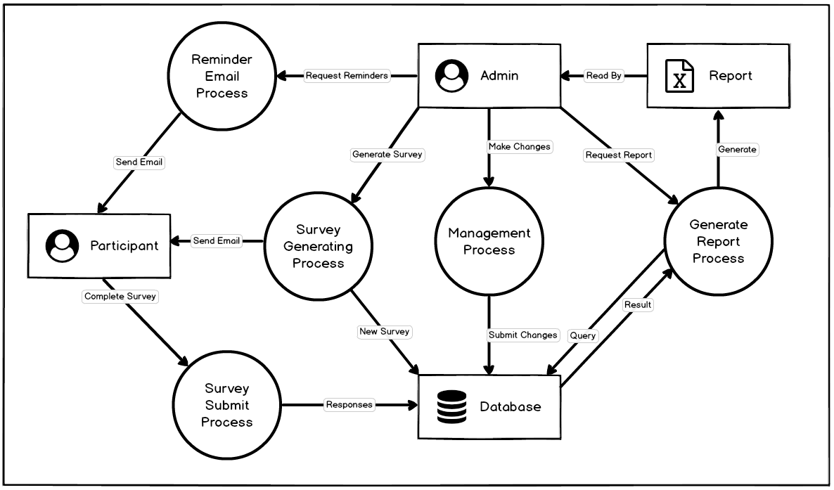
System Model

